Slide 1
How will you rotate a unit cube 90º about an axis defined by its endpoints A(2,1,0) and B(3,3,1).
Step 7
Translate end point back to (2, 1, 0)
y
(3,3,1)
(2,1,0)
x
z

Slide 2
Rotation about an Arbitrary Plane
What do you mean by affine transformation? How would you reflect an object with respect to a plane passing thru point P(1,2,3) and having a normal vector N=I+J+K?
Here,
1.Translate the point by T(-1,-2,-3) to make the plane pass thru origin
2.Then align the normal with the z axis for that rotate the normal two times first about x axis in ccw , then about y axis in cw direction then
3.Take reflection of object about xy plane
4.Now perform inverse rotations about y then x axis
5.Then retranslate the plane along with the reflected object

Slide 3
Reflection about an Arbitrary Plane
Hints:
Spatial orientation of a plane in 3D space is given by its outward normal
Translate plane so that it passes thru origin
Rotate the Normal two times so that it gets aligned with z axis and the plane lands on xy plane
Take reflection of object about that plane
Perform inverse rotations and translation
z
z
x
x
y
y

Slide 4
Reflection about an Arbitrary Plane
Step 1
Translate the plane along with the object to be reflected about it so that the plane passes thru origin
z
x
y

Slide 5
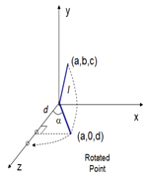
Reflection about an Arbitrary Plane
Step 2
Rotate the normal about x then y axis so that the normal is aligned with z axis and the plane is aligned with xy plane
z
(1,1,1)
x
Here, n = i+j +k so (a,b,c) = (1,1,1) its projection is (0,b,c ) = (0,1,1) in this case
So length of axis is sqrt 3 and length of is shadow is sqrt 2
y

Slide 6
Reflection about an Arbitrary Plane
Step 3
Reflect the object about the xy plane with which the plane has been aligned
z
x
y

Slide 7
Reflection about an Arbitrary Plane
Step 3
Reflect the object about the xy plane with which the plane has been aligned
z
x
y

Slide 8
Reflection about an Arbitrary Plane
Step 4
Rotate the normal about y then x axis so that the normal is de-aligned from z axis and the plane is de-aligned with xy plane
z
x
y

Slide 9
Reflection about an Arbitrary Plane
Step 5
Translate the plane along with the reflected object back to its original location
z
x
y

Slide 10
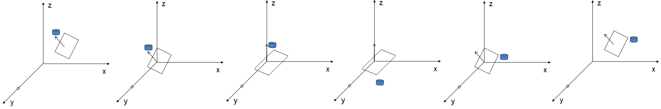
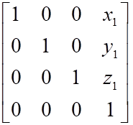
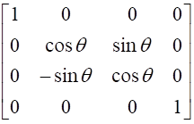
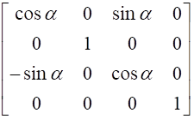
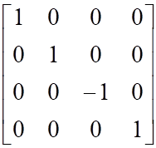
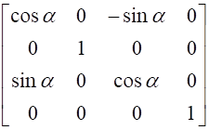
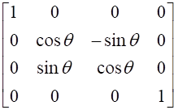
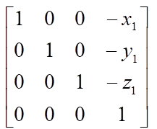
Reflection about an Arbitrary Plane
CM=

